Slide 1
SQL Functions – Character functions Dr Mariana Rocha School of Computer Science
CPMU 2007 Databases 1, Lecture 5

Slide 2
What are Functions in SQL
So far, we have looked at how we can use SELECT queries to find specific values
Functions are pre-built pieces of functionality that we can perform on our databases quickly and easily
Functions can allow us to
Perform calculations on data
Modify individual data items
Manipulate output for groups of rows
Format dates and numbers for display
Convert column data types

Slide 3
SQL Functions
SQL Functions
SQL functions sometimes take arguments and always return a value.
SQL has a long list of built-in functions

Slide 4
SQL Functions
SQL Functions
Input
Output
Function
arg 1
Function performs action
arg 2
Result
value
arg n

Slide 5
Types of SQL Functions
Functions
Single-row
functions
Multiple-row
functions
Return one result
per row
Return one result
per set of rows
Notes:
SQL Functions (continued)
There are two types of functions:
Single-row functions
Multiple-row functions
Single-Row Functions
These functions operate on single rows only and return one result per row. There are different types of single-row functions. This lesson covers the following ones:
Character
Number
Date
Conversion
General
Multiple-Row Functions
Functions can manipulate groups of rows to give one result per group of rows. These functions are also known as group functions (covered in a later lesson).
Note: For more information and a complete list of available functions and their syntax, see Oracle SQL Reference.

Slide 6
Single-row functions
Single-row functions:
Manipulate data items
Access and works on each row and return a value per row
May return a value of a data type different to that referenced
Can be nested
Accept arguments that can be a column or an expression
function_name [(arg1, arg2,...)]
Notes:
Single-Row Functions
Single-row functions are used to manipulate data items. They accept one or more arguments and return one value for each row that is returned by the query. An argument can be one of the following:
User-supplied constant
Variable value
Column name
Expression
Features of single-row functions include:
Acting on each row that is returned in the query
Returning one result per row
Possibly returning a data value of a different type than the one that is referenced
Possibly expecting one or more arguments
Can be used in SELECT, WHERE, and ORDER BY clauses; can be nested
In the syntax:
function_name is the name of the function
arg1, arg2 is any argument to be used by the function. This can be represented by a column name or expression.

Slide 7
Single-row functions
An argument can be one of the following:
User-supplied constant
Column name
Expression
Can be used in
Select
Where
Order By
Constraint
function_name [(arg1, arg2,...)]
Notes:
Single-Row Functions
Single-row functions are used to manipulate data items. They accept one or more arguments and return one value for each row that is returned by the query. An argument can be one of the following:
User-supplied constant
Variable value
Column name
Expression
Features of single-row functions include:
Acting on each row that is returned in the query
Returning one result per row
Possibly returning a data value of a different type than the one that is referenced
Possibly expecting one or more arguments
Can be used in SELECT, WHERE, and ORDER BY clauses; can be nested
In the syntax:
function_name is the name of the function
arg1, arg2 is any argument to be used by the function. This can be represented by a column name or expression.

Slide 8
Single-row functions
Character
Accept character input
Returns a single value
Can return both character and numeric values
Handle NULL values or selection of return value based on choices
General
Single-row
functions
Number
Accepts numeric input
Returns a single numeric value
\
Conversion
Date
Convert a value from one data type to another
Operate on date data type
Returns a value of date data type
Notes:
Single-Row Functions (continued)
This lesson covers the following single-row functions:
Character functions: Αccept character input and can return both character and number values
Number functions: Accept numeric input and return numeric values
Date functions: Operate on values of the DATE data type (All date functions return a value of DATE data type except the MONTHS_BETWEEN function, which returns a number.)
Conversion functions: Convert a value from one data type to another
General functions:
NVL
NVL2
NULLIF
COALESCE
CASE
DECODE

Slide 9
Character
functions
Case-manipulation
functions
Character-manipulation
functions
LOWER
UPPER
INITCAP
CONCAT
SUBSTR
LENGTH
INSTR
LPAD
RPAD
TRIM
REPLACE
Notes:
Character Functions
Single-row character functions accept character data as input and can return both character and numeric values. Character functions can be divided into the following:
Case-manipulation functions
Character-manipulation functions
Note: The functions discussed in this lesson are only some of the available functions.

Slide 10
Character
functions
ClientS
clientID | Number(6)
Fullname | Varchar2(20)
Case-manipulation
functions
clientId | Fullname
1 | Joe Bloggs
2 | Jim bloogs
Function | Result
SELECT LOWER(Fullname) FROM Clients; | joe bloggs jim bloogs
SELECT UPPER(Fullname) FROM Clients; | JOE BLOGGS JIM BLOOGS
SELECT INITCAP(Fullname) FROM Clients; | Joe Bloggs Jim Bloogs
Notes:
Character Functions
Single-row character functions accept character data as input and can return both character and numeric values. Character functions can be divided into the following:
Case-manipulation functions
Character-manipulation functions
Note: The functions discussed in this lesson are only some of the available functions.

Slide 11
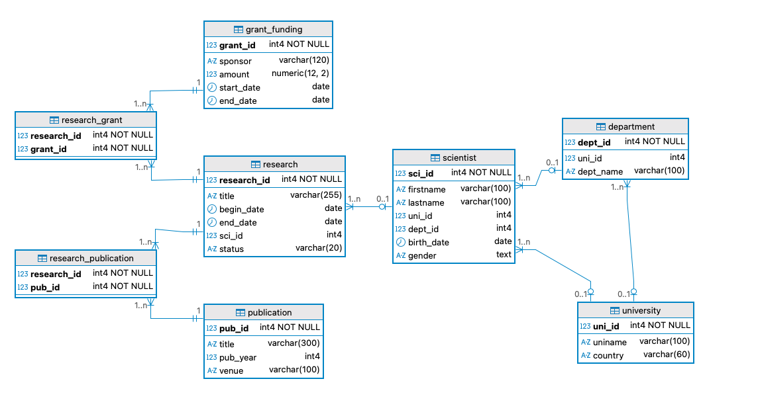
We will look at examples using the following database

Slide 12
Case manipulation: upper( ) and lower( )
Character functions can be used to convert strings to uppercase or lowercase using the UPPER( ) and LOWER( ) functions.
-- Uppercase research titles for display
SELECT title, UPPER(title) "Upper Title"
FROM research;
-- Lowercase venues for standardised export
SELECT venue, LOWER(venue) "Lower Title"
FROM publication;
Notes:
Character Functions
Single-row character functions accept character data as input and can return both character and numeric values. Character functions can be divided into the following:
Case-manipulation functions
Character-manipulation functions
Note: The functions discussed in this lesson are only some of the available functions.

Slide 13
Case manipulation: upper( ) and lower( )
It can also be used to manipulate WHERE conditions.
-- Case-insensitive search for a scientist by last name
SELECT firstname, lastname
FROM scientist
WHERE LOWER(lastname) = 'murphy';
Notes:
Character Functions
Single-row character functions accept character data as input and can return both character and numeric values. Character functions can be divided into the following:
Case-manipulation functions
Character-manipulation functions
Note: The functions discussed in this lesson are only some of the available functions.

Slide 14
Character
functions
Character-manipulation
functions
Function | Result | Objective
CONCAT('Hello', 'World') | HelloWorld | Concatenate
SUBSTR('HelloWorld',1,5) | Hello | Extract
LENGTH('HelloWorld') | 10 | Check length
POSITION('W’ IN ‘Hello World') | 6 | Find position of first occurrence
LPAD('tech', 8, '0'); | 0000tech | Pads the left
RPAD('tech', 8, '0') | tech0000 | Pads the right
REPLACE ('JACK and JUE','J','BL') | BLACK and BLUE | Replace character
TRIM('H' FROM 'HelloWorld') | elloWorld
Notes:
Character Functions
Single-row character functions accept character data as input and can return both character and numeric values. Character functions can be divided into the following:
Case-manipulation functions
Character-manipulation functions
Note: The functions discussed in this lesson are only some of the available functions.

Slide 15
Case manipulation: concatenate( )
It can be used to modify how the data is presented:
SELECT CONCAT(TRIM(firstname), ' ', TRIM(lastname), ' (', TRIM(uniname), ')') " Scientist affiliation"
FROM scientist
JOIN university USING (uni_id);
Notes:
Character Functions
Single-row character functions accept character data as input and can return both character and numeric values. Character functions can be divided into the following:
Case-manipulation functions
Character-manipulation functions
Note: The functions discussed in this lesson are only some of the available functions.

Slide 16
Case manipulation: substring( )
Extracts part of a string:
-- First 5 chars of university names (spot prefixes & duplicates)
SELECT uniname,
SUBSTRING(uniname FROM 1 FOR 10) "Uni prefix"
FROM university;
Notes:
Character Functions
Single-row character functions accept character data as input and can return both character and numeric values. Character functions can be divided into the following:
Case-manipulation functions
Character-manipulation functions
Note: The functions discussed in this lesson are only some of the available functions.

Slide 17
Case manipulation: length( )
The LENGTH function returns the length of a string. It can be used for data validation or to manage constraints.
-- Research title length
SELECT research_id, LENGTH(title) "Research title length"
FROM research
ORDER BY title_len DESC;
Notes:
Character Functions
Single-row character functions accept character data as input and can return both character and numeric values. Character functions can be divided into the following:
Case-manipulation functions
Character-manipulation functions
Note: The functions discussed in this lesson are only some of the available functions.

Slide 18
Case manipulation: position( )
Find the position of a substring within a string in the database you provided earlier
-- Find titles mentioning 'AI' anywhere
SELECT research_id, title,
POSITION('AI' IN UPPER(title)) "Position AI"
FROM research
WHERE POSITION('AI' IN UPPER(title)) > 0;
Notes:
Character Functions
Single-row character functions accept character data as input and can return both character and numeric values. Character functions can be divided into the following:
Case-manipulation functions
Character-manipulation functions
Note: The functions discussed in this lesson are only some of the available functions.

Slide 19
Case manipulation: lpad( ) and rpad( )
Pads a string on the left or right side with a specified character or characters until it reaches the desired length.
These functions are mostly used for formatting the data in a certain way. The syntax is:
LPAD(string, length, fill_string) or LRPAD(string, length, fill_string)
Notes:
Character Functions
Single-row character functions accept character data as input and can return both character and numeric values. Character functions can be divided into the following:
Case-manipulation functions
Character-manipulation functions
Note: The functions discussed in this lesson are only some of the available functions.

Slide 20
Case manipulation: lpad( ) and rpad( )
-- Zero-padded research codes (for reports)
SELECT research_id, 'RS-' || LPAD(CAST(research_id AS VARCHAR), 5, '0') "Research code"
FROM research
ORDER BY 1;
Notes:
Character Functions
Single-row character functions accept character data as input and can return both character and numeric values. Character functions can be divided into the following:
Case-manipulation functions
Character-manipulation functions
Note: The functions discussed in this lesson are only some of the available functions.

Slide 21
Case manipulation: replace( )
Used to replace occurrences of a substring within a string.
-- Normalise hyphenated last names to space-separated
SELECT sci_id,
lastname "Last name",
REPLACE(lastname, '-', ' ') "Normalised lastname"
FROM scientist
WHERE lastname LIKE '%-%';
Notes:
Character Functions
Single-row character functions accept character data as input and can return both character and numeric values. Character functions can be divided into the following:
Case-manipulation functions
Character-manipulation functions
Note: The functions discussed in this lesson are only some of the available functions.

Slide 22
Case manipulation: trim( )
Removes leading and trailing spaces from a string. Trim function is mostly used for database cleanup and formatting.
-- Clean leading/trailing spaces from names
SELECT firstname "Raw first name", length(firstname) "First name size",
TRIM(firstname) "Trimmed first name", length(trim(firstname)) "First name size after trimming"
FROM scientist
WHERE firstname LIKE ' %' OR firstname LIKE '% ';
Notes:
Character Functions
Single-row character functions accept character data as input and can return both character and numeric values. Character functions can be divided into the following:
Case-manipulation functions
Character-manipulation functions
Note: The functions discussed in this lesson are only some of the available functions.

Slide 23
Adding a WHERE clause
-- Case-insensitive exact match for a project code prefix within the title
SELECT *
FROM research
WHERE LOWER(title) LIKE '%quantum study';
-- Case-sensitive (likely fewer or no matches, depending on data)
SELECT *
FROM research
WHERE title LIKE '%quantum study';

Slide 24
Another way of concatenating
We can concatenate values using || or the function concat( ).
Concat( ) can be a bit more efficient when we have many arguments.
-- Using ||
SELECT 'Scientist ' || sci_id || ': ' || UPPER(lastname) || ', ' || INITCAP(TRIM(firstname)) "Information"
FROM scientist
LIMIT 10;
-- Using CONCAT (two-arg chaining)
SELECT CONCAT('Scientist ', sci_id, ': ', UPPER(lastname), ', ', INITCAP(TRIM(firstname))) "Information"
FROM scientist
LIMIT 10;

Slide 25
Another way of concatenating
Be aware: when we use || to concatenate two values and one is NULL, the result is a NULL value. This way:
'a' || NULL → NULL
CONCAT('a', NULL) → 'a’
As we usually prefer to keep any value that is not null, give preference to using concat( )
You can also use concat_ws( sep, arg), which will take a separator and arguments, skipping the NULL ones. Ws stands for “with separator”
SELECT 'a' || NULL;
SELECT concat('a', NULL);
SELECT concat_ws(' , ', 'a', NULL, 'b');

Slide 26
Nesting functions
Single-row functions can be nested
Nested functions are evaluated from deepest level to the least deep level.
F3(F2(F1(col,arg1),arg2),arg3)
Step 1 = Result 1
Step 2 = Result 2
Step 3 = Result 3
Notes:
Nesting Functions
Single-row functions can be nested to any depth. Nested functions are evaluated from the innermost level to the outermost level. Some examples follow to show you the flexibility of these functions.

Slide 27
Nesting functions
--Nested functions
-- Lastname stub + country suffix, uppercased
SELECT lastname,
UPPER(CONCAT(SUBSTRING(REGEXP_REPLACE(lastname, '\s+', '', 'g') FROM 1 FOR 8), '_IRL’)) “Tag”
FROM scientist
JOIN university USING (uni_id)
WHERE university.country = 'Ireland'
LIMIT 15;

Slide 28


